Slide 1
Modeling of Data
Physics 113 – 02/25/21

Slide 2
General Problem setup
Given a set of observations, want to summarize data by fitting a model
Model depends on a set of adjustable parameters
Models can come from underlying theory to explain the observations or they can be simply used to interpolate or extrapolate the observations.
Approach: Define ’Merit function’ that measures agreement between observations and model with particular set of parameters.
The parameters of the model are adjusted to find an extremum (’best fit’) of the merit function -> Optimization!

Slide 3
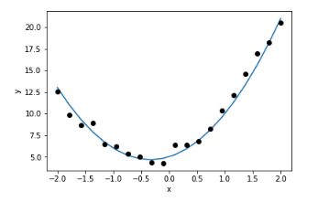
Example (Simple)
A 1 dimensional quadratic model
A multidimensional quadratic model

Slide 4
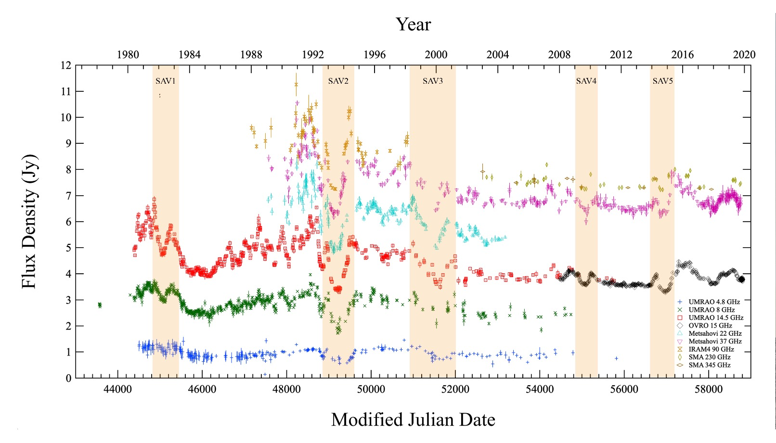
Example (Advanced)
Fitting a gravitational lens magnification pattern to PKS 1413+135

Slide 5
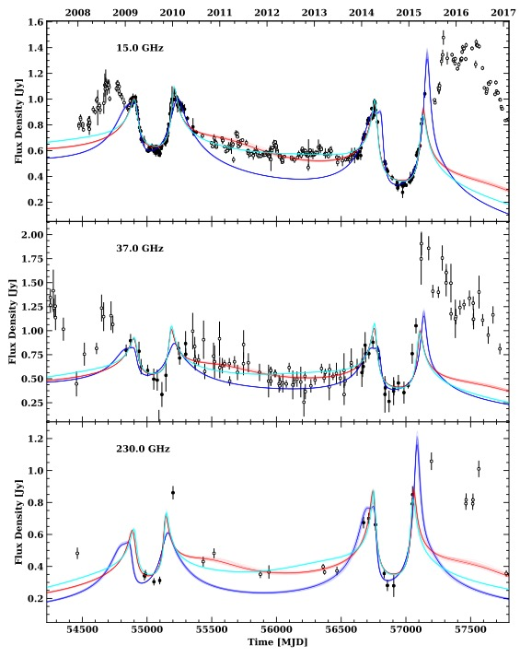
Very different models, same fitting paradigm.

Slide 6
Outline
Goodness of fit and merit functions
Least squares
Linear models
Errors
Regularization
Nonlinear models
Markov Chain Monte Carlo

Slide 7
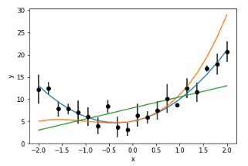
Likelihood Function
Probability of your data given your model
Measured data always has some degree of uncertainty.
Even if your model is perfectly specified, your likelihood will never be L = 1.

Slide 8
Likelihood Function
The likelihood function can be used as a merit function: the model parameters that best fit your data maximize the likelihood function.
Its often easier minimize the log-likelihood function:
The specific likelihood function used depends on the error distribution of your data.
If the data points are independent and have Gaussian errors:
Notes:
Gaussian errors good assumption because of the CLT

Slide 9
Chi-Squared
Sum of squared residuals
Follows a chi-squared distribution with (N-k) degrees of freedom
A chi-squared distribution has mean (N-k) and variance 2(N-k)
Reduced chi squared (mean 1, variance 2/(N-k) ):

Slide 10
Summary
To find the model parameters that best fit the data, we minimize the negative log-likelihood.
Maximum Likelihood estimation.
For Gaussian distributed, independent data, this means minimizing the sum of squared residuals (‘Least squares’).
Examples of non-gaussian situations: Counts in a detector (Poisson), resonance energy of rare particle (Cauchy).
Notes:
Some examples

Slide 11
Least squares with linear models
Linear models are any models that are linear in the parameters to be estimated, e.g.
Linear
Non-Linear

Slide 12
Least Squares with linear models
Any linear model can be written in matrix form:
If we have a set of observations, we can write a system of linear equations:

Slide 13
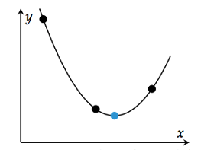
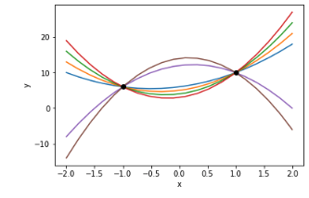
If N == 3, then there can be only one exact solution for (a,b,c).
If N < 3, there are many (infinite) exact solutions for (a,b,c).
If N > 3, the system is underdetermined. There are likely no exact solutions for (a,b,c)

Slide 14
Minimizing the Merit function
For linear models, we can minimize the merit function analytically:

Slide 15
What about with data errors?
Just add in the weight matrix:

Slide 16
Errors on our model parameter estimates
Now we have our parameter estimates, what are the errors on ?
For linear models with gaussian errors we can get these analytically:
Notes:
Just want to make the point that with least squares you get absolutely everything analytically

Slide 17
Linearization: the power of linear models
Always guaranteed you have best solution
All the information you want derived analytically (estimates, errors on estimates)
For non-linear problems, you can always try to linearize:
Many machine learning problems solved quite well with linear models.

Slide 18
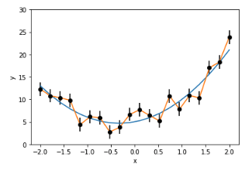
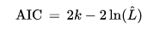
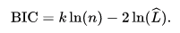
Assessing goodness of fit
Reduced Chi Squared
Akaike Information criterion
Bayesian Information Criterion
Overfitting -> Useful in interpolation, bad for model fitting
Notes:
Allow you to compare between models

Slide 19
Techniques to prevent overfitting
Use a simpler model
Collect more (independent) data
Regularization:
Notes:
Realm of machine learning here, equivalent to gaussian prior with mean 0 and variance 1/mu

Slide 20
Non-linear Models
What if your model is non-linear (or the errors are non-Gaussian)?
Now there is no analytic solution to the minimization problem:
Can use minimization methods from the previous lecture!
Gradient Descent, Newton’s method etc.
There may be many local minima, difficult to guarantee that you have found the best solution.
No analytic way to get errors on your parameter estimates.
Notes:
For linear problems you can hand the proven best solution immediately, the Subset of problems called convex that can be solved with guarantees. We also want errors on our estimates, lead into MCMC

Slide 21
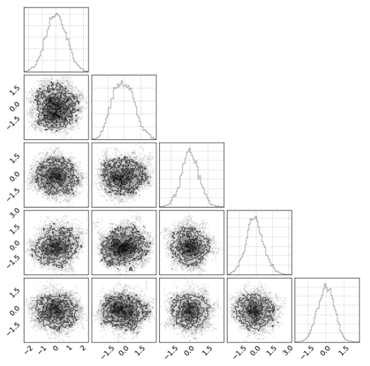
Markov Chain Monte Carlo
Stochastic Optimization method
No gradients or Hessians required
Randomly samples theta space to (hopefully) give full posterior distribution for theta.
Popular in Astrophysics
Posterior
Likelihood
Prior

Slide 22
Useful to use log probabilities
An uninformative prior is often used
For model fitting with Gaussian errors:

Slide 23
How can we sample from ?
Metropolis-Hastings Algorithm
Use a Markov Chain model: Probability of selecting next point only depends on current and previous point.
Set Gaussian proposal distribution:
Starting at draw a candidate point from q,
3. Accept point with probability
Otherwise reject and
4. Repeat.
Notes:
Converges to p(theta|x) after a large number of steps

Slide 24
In our case
Uniform prior and
This means:

Slide 25
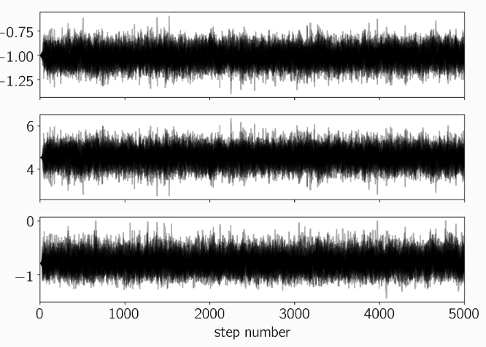
How many steps before convergence?
Open Question
Usually have a burn in period
Advisable to thin points to reduce correlation
Notes:
Want independent samples from posterior

Slide 26
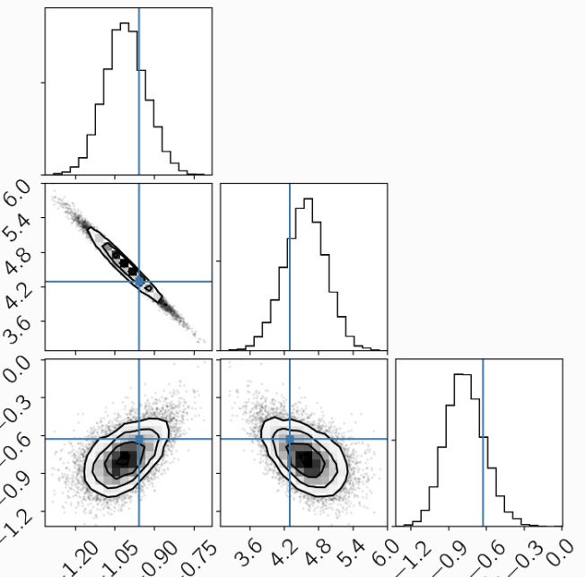
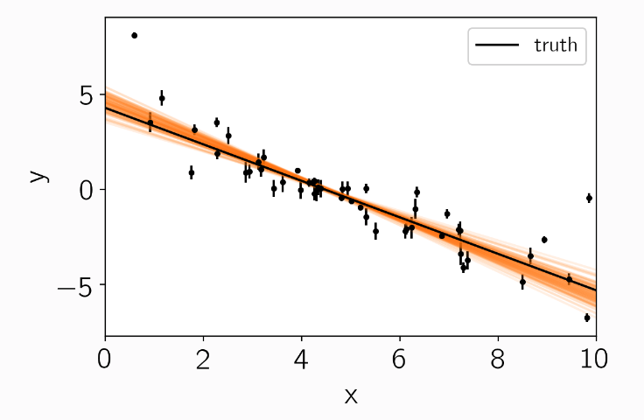
Corner Plot
Once finished, you will end up with the sampled posterior distribution.
Can represent as a corner plot.

Slide 27
Example
https://github.com/chi-feng/mcmc-demo#ref-2

Slide 28
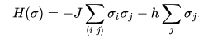
Example 2D Ising model

Slide 29
Hamiltonian MCMC
Uses gradient information (so often not possible to use)
Typically much more efficient than standard Metropolis-Hastings

